Slide 1

SESHADRI RAO GUDLAVALLERU ENGINEERING COLLEGE Department of CSE(Aritificial Intelligence & Machine Learning) Community Service Project
on
EchoHands : Bridging voice and gestures.
PRESENTED BY BATCH B14
N. Srija (22481A4280)
T. Niteesha (22481A42B4)
V. Keerthi (22481A42C0)
P. Likhita (23485A4213)
Under the Guidance of
Mr. A. Manoj Kumar
ASSISTANT PROFESSOR, DEPARTMENT OF CSE(ARTIFICIAL INTELLIGENCE AND MACHINE LEARNING)

Slide 2
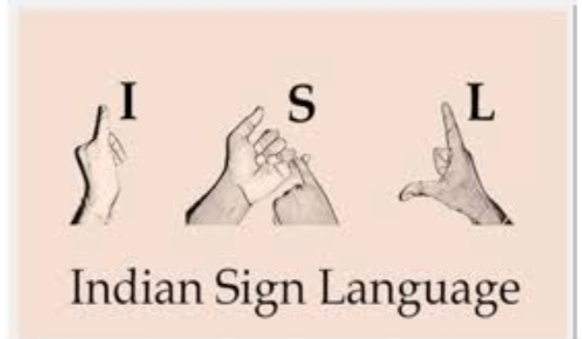
Contents
Abstract
Problem overview
Solution overview
Technology stack
Deployment screen
Conclusion

Slide 3
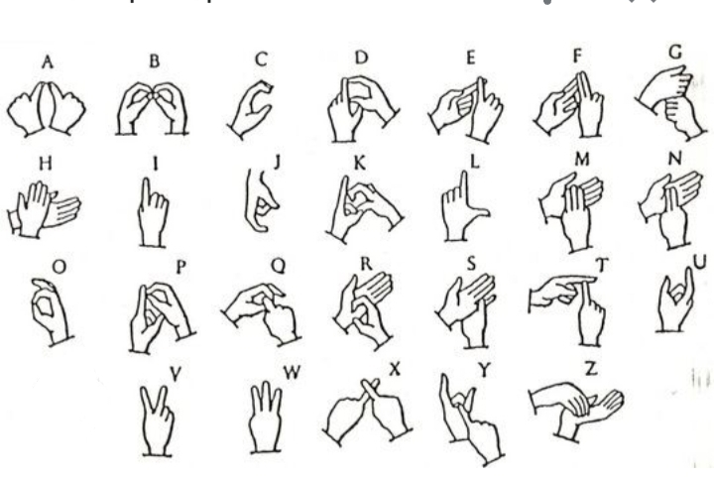
ABSTRACT
Sign language is a visual language that is used by deaf people as their mother tongue.
Communication is the difficulty faced by deaf people with normal people as everyone does not know the sign language.
The aim of the project is to develop a communication system which converts voice into the sign language.

Slide 4
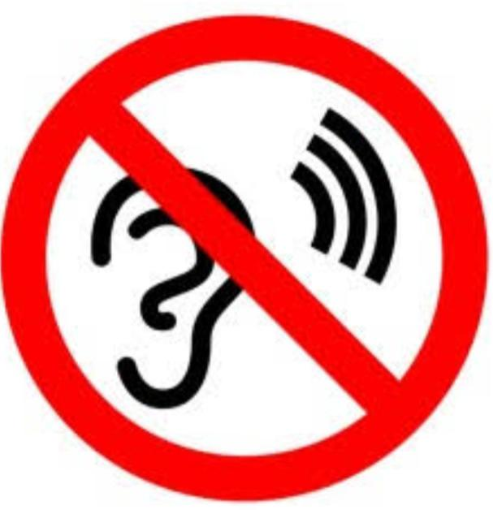
Problem overview
Problem arises when people that are impaired tries to communicate with normal people.
The reason is that they mostly communicate using sign language but most of the people don’t know the sign language.
So this project helps them to understand what normal people are speaking through sign language.

Slide 5

Solution overview
Our proposed system is designed to overcome the problem faced by deaf and dumb people.
This system is designed to translate every word spoke by normal people into sign language.
Through this specially abled people are able to understand what is going on around them.

Slide 6
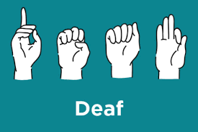
Technology stack
Software Details:
Programming Language:Python3
Packages Used: opencv, tensorflow
Framework: Django
Hardware Details:
Device(mobile/laptop)
Mic
Monitor to view
Web browser

Slide 7
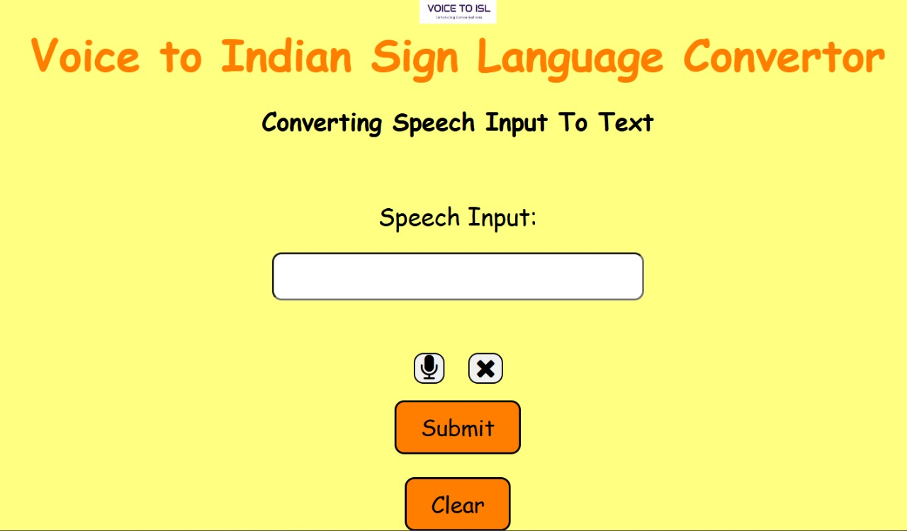
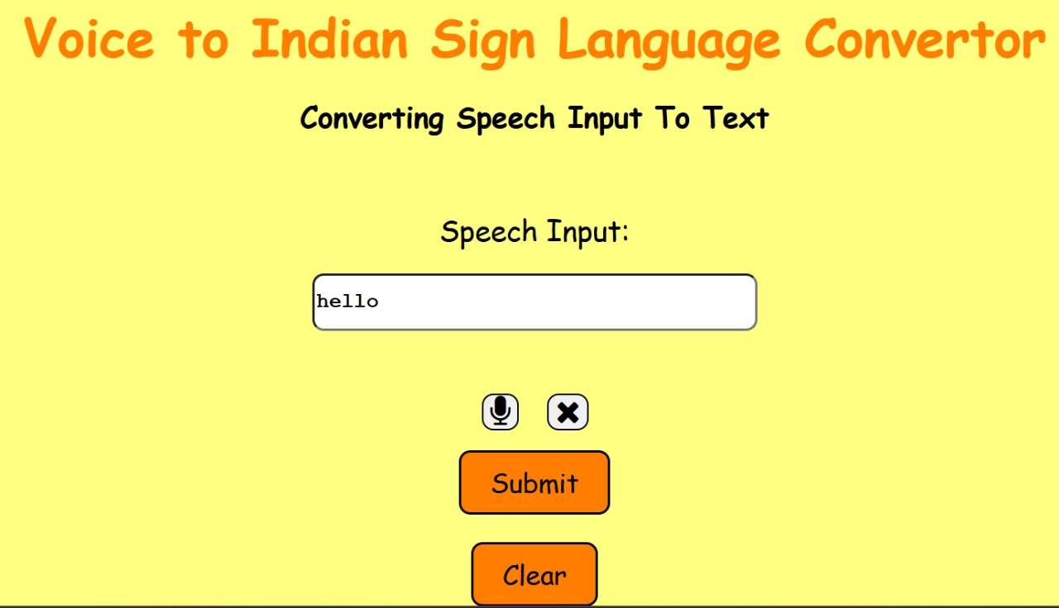
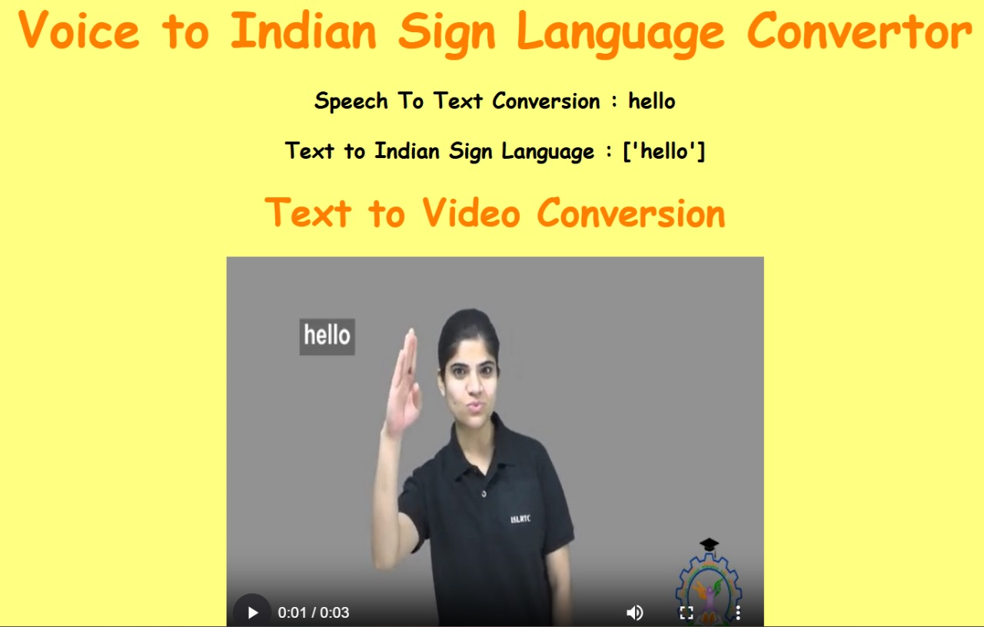
DEPLOYMENT SCREEN

Slide 8

CONCLUSION
For hearing-impaired people, speech to sign language translation is essential in the modern era of online communication. This will close the communication gap between those with normal hearing andthose with hearing loss.

Slide 9


